Slide 1
Cross Validation (Simple Meaning)
Cross validation means testing a model using different parts of the same data.
Instead of using all data at once, we split data into parts.
This helps us check how well the model works on new, unseen data.
Think of it like studying with practice tests before the final exam.

Slide 2
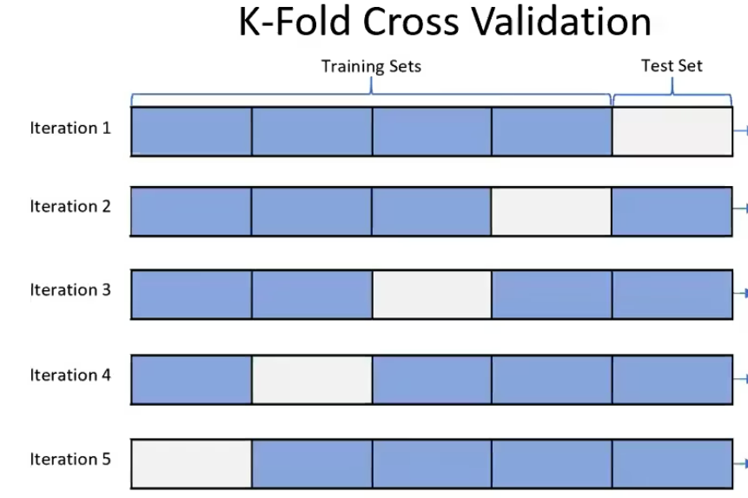
K-Fold Cross Validation
Data is divided into K equal parts (folds).
Model is trained on K-1 parts and tested on the remaining 1 part (in 100- training 80%,testing- 20%).
This process is repeated K times in diagonal way.
Final result is the average of all test results.
Example: 5-fold means data is split into 5 parts.

Slide 3
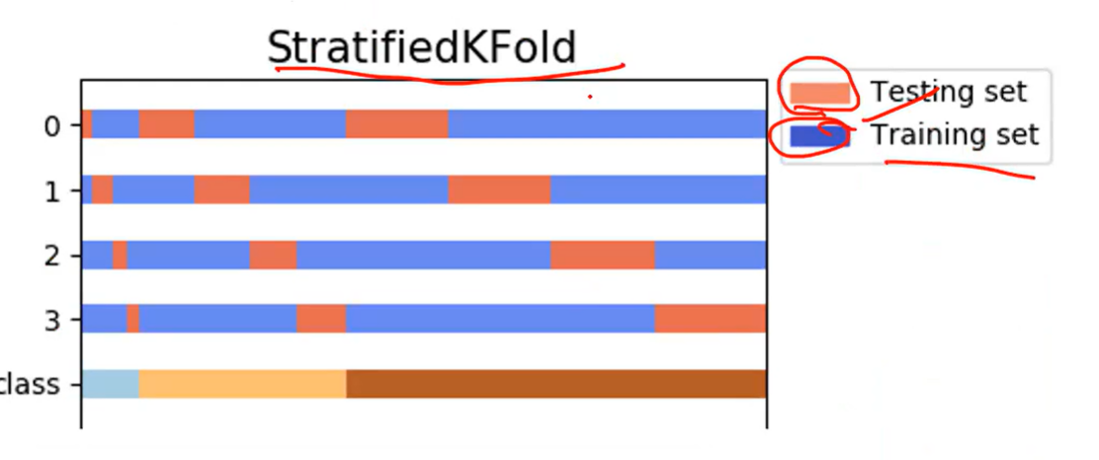
Stratified Cross Validation
This is similar to K-Fold, but with one extra care.
Each fold keeps the same proportion of classes.but it takes testing at any where in test data.
Useful when data has unequal categories (like pass/fail).
Ensures fair testing for all types of data.

Slide 4
Leave-One-Out Cross Validation (LOOCV)
Only one data point is kept for testing.
All remaining data is used for training.
This is repeated for every data point.
Very accurate but takes more time.

Slide 5
Hold-Out Method
Data is split only once.
One part for training and one part for testing.
Example: 50% training, 50% testing.
Simple and fast, but results depend on the half split only so high chances of protentional scenarios being missed before production.

